Slide 1
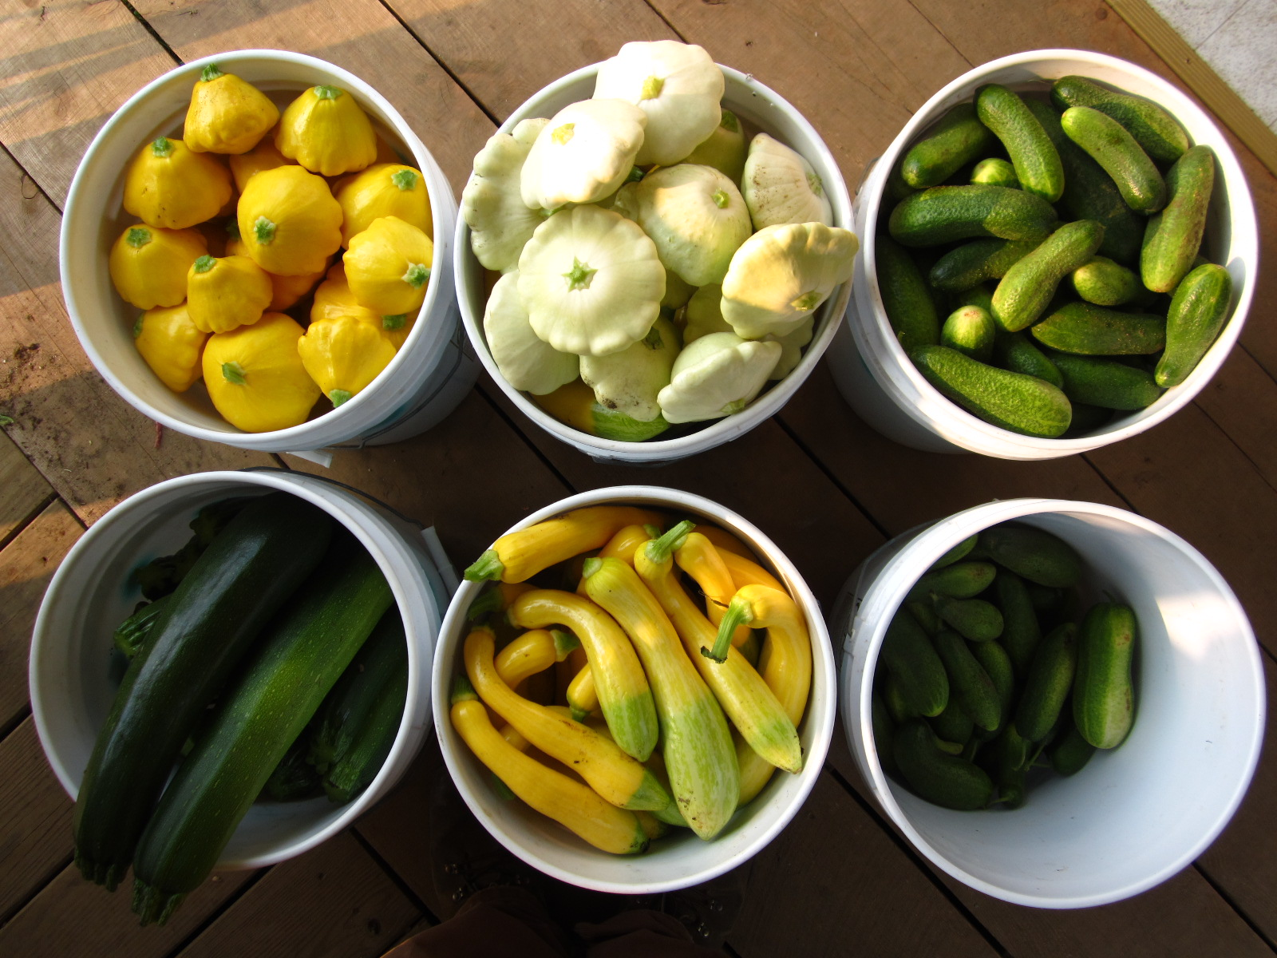
A Small-Scale Washing and Cooling Unit
Flywheel Farm, LLC Woodbury, Vermont

Slide 2
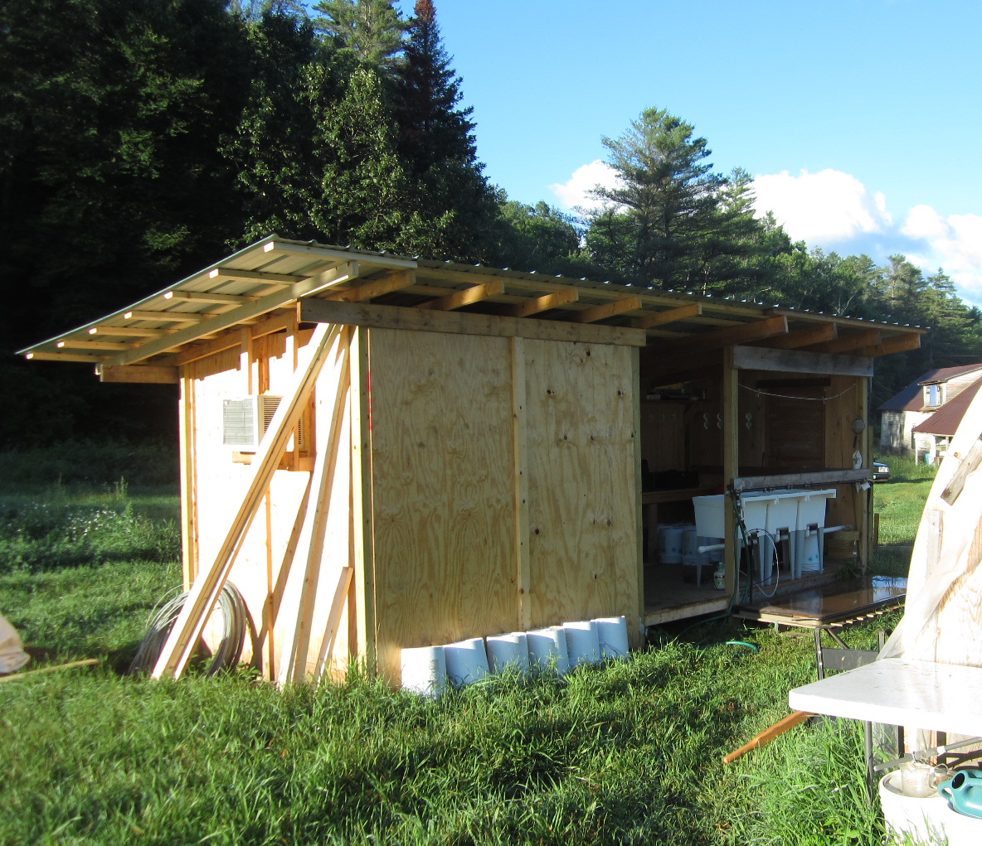
Flywheel Farm - started 2013
Diverse: fruit, veggie, small livestock
Current acreage in production: 2; Max: 4
30% retail, 70% wholesale
8’x20’ Packhouse and Walk-in Cooler

Slide 3
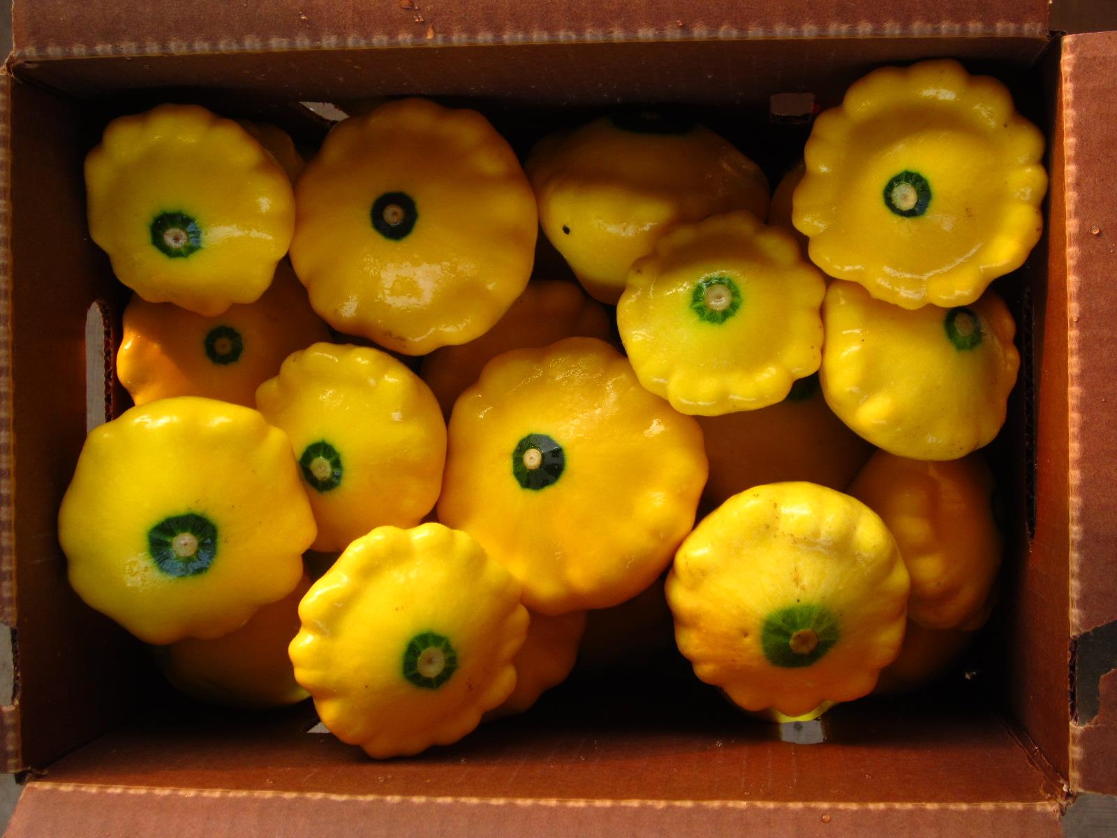
What do we want to accomplish with our Packhouse and Walk-in?
Efficient Use of Labor
Quality Produce

Slide 4
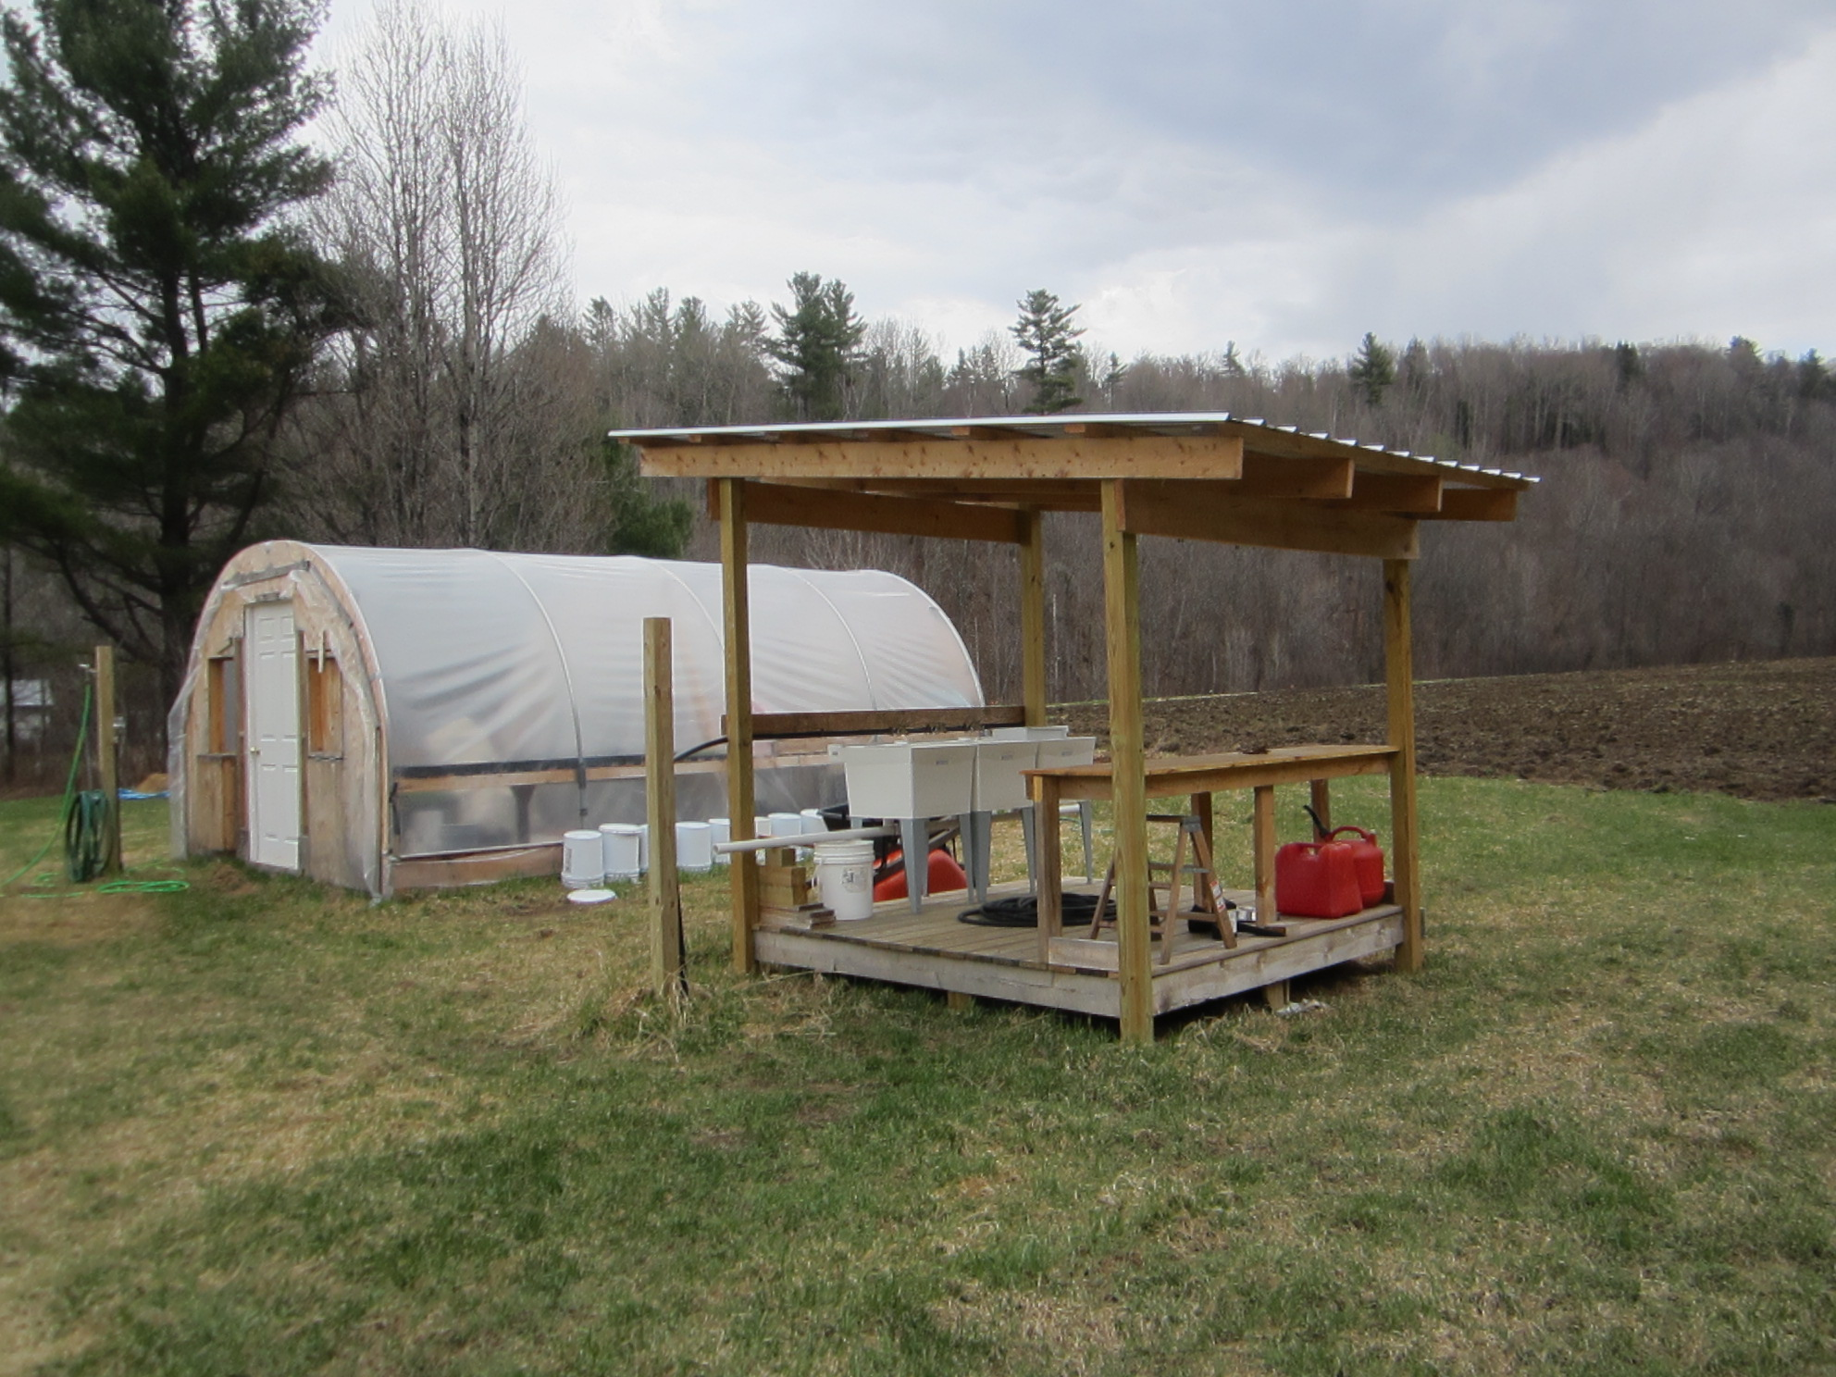
2013
8’ x 8’ structure using a woodshed design.
No electric, no phone.
3 plastic utility sinks, salad spinner, table, floor, roof.

Slide 5
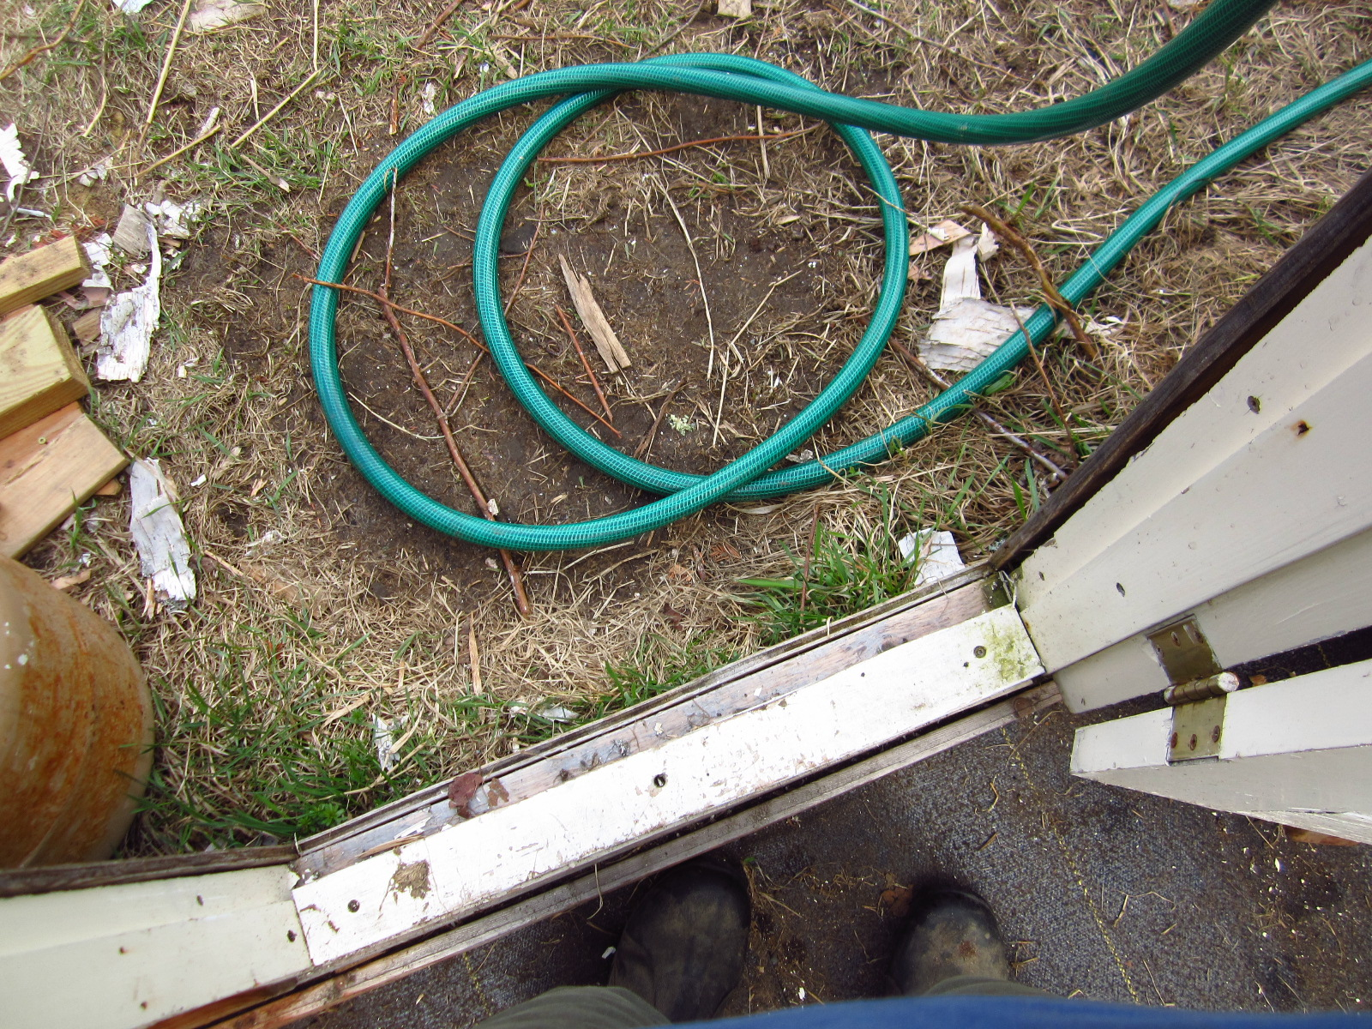
Past Experiences/Seen on Other Farms
Considering Efficiency, Ease of Use, Cleanliness
We disliked…
Manual dumping of H₂O
Mix ‘n match basins
Bathtubs
Unreachable/lost spaces
Filling tubs with hoses
Exposure to rain/snow
Systems that require constant reconfiguration
Systems that require more than one person
We liked…
- Laundry/Utility sinks
Empty, Cleanable tabletops and floors
Lots of air-flow and light
Floors that drain
Cooler close to Packing
Cool-bots

Slide 6
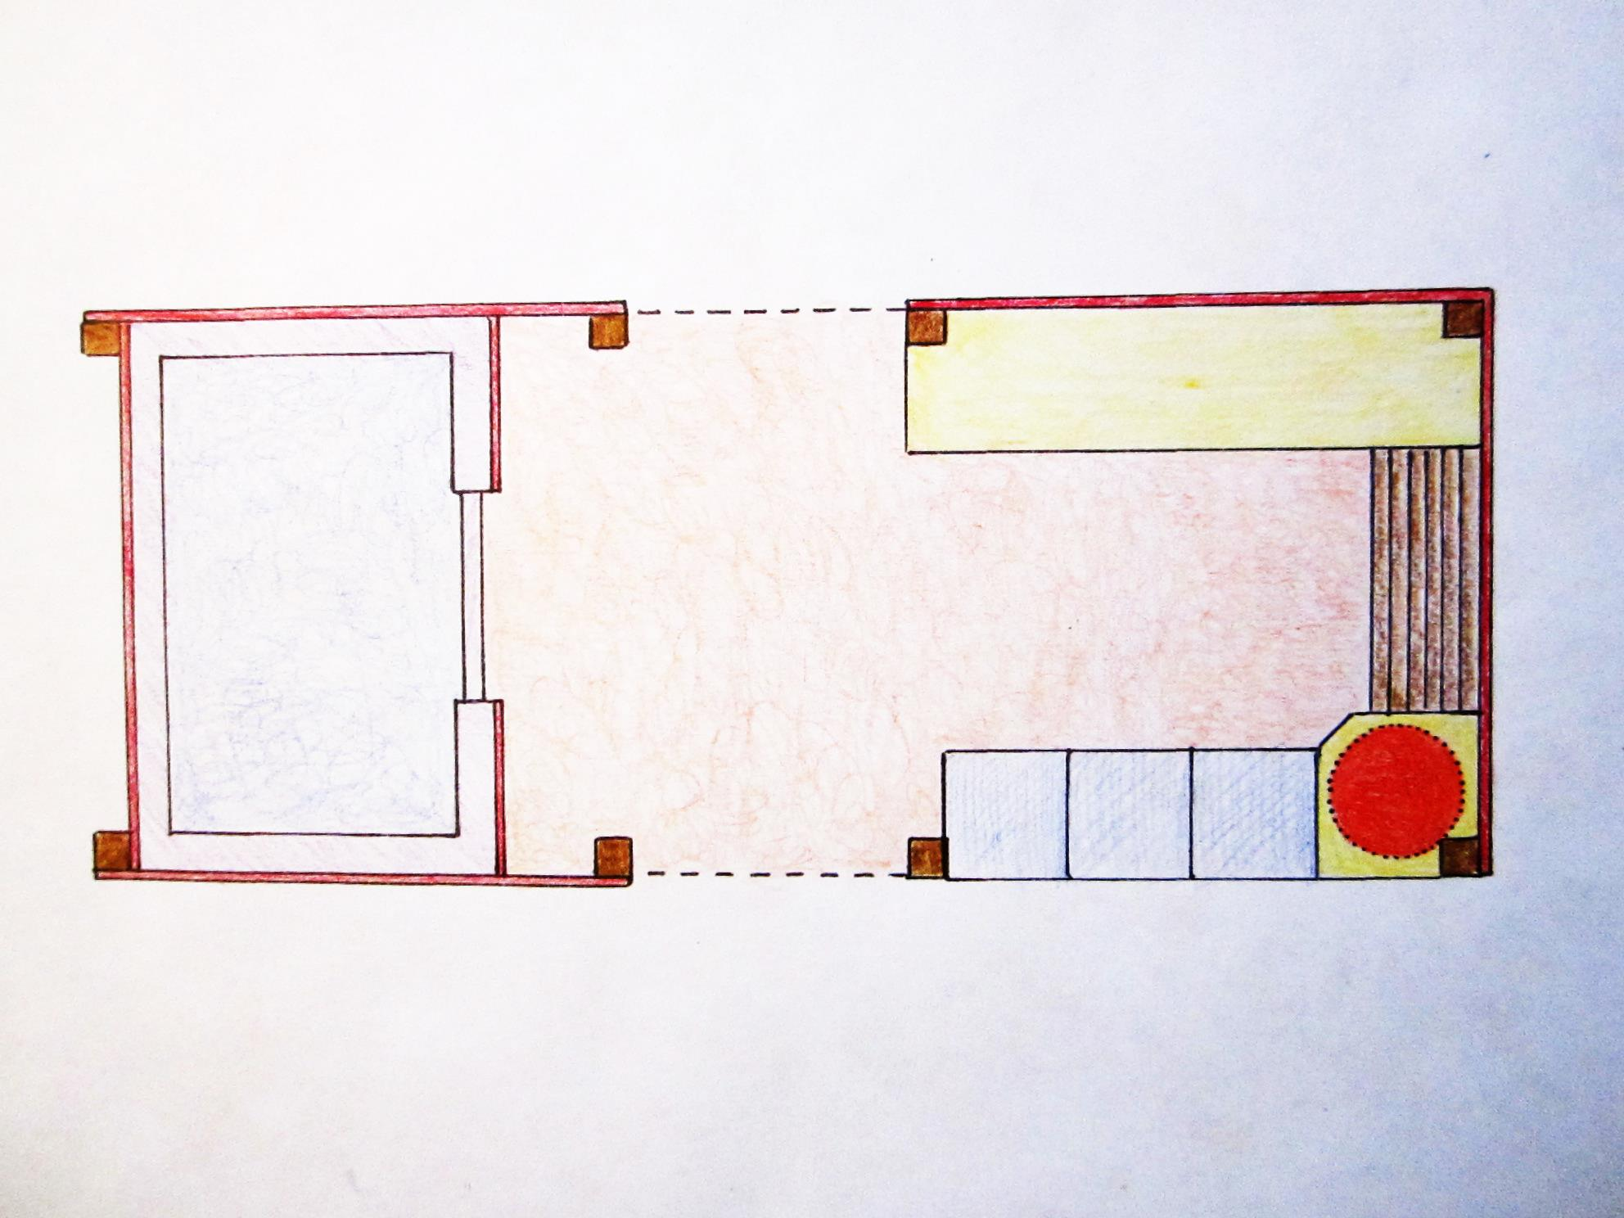
8’ x 20’ Packhouse & Cooler
ELECTRIC
INTERNET
PACK TABLE
COOLER
5 x 7 x 6
210 cu ft
PRESSURE TREATED DECK
LOW DRAIN
TABLE
SINKS
PHONE
SALAD SPINNER
HARVEST TOTE STORAGE

Slide 7
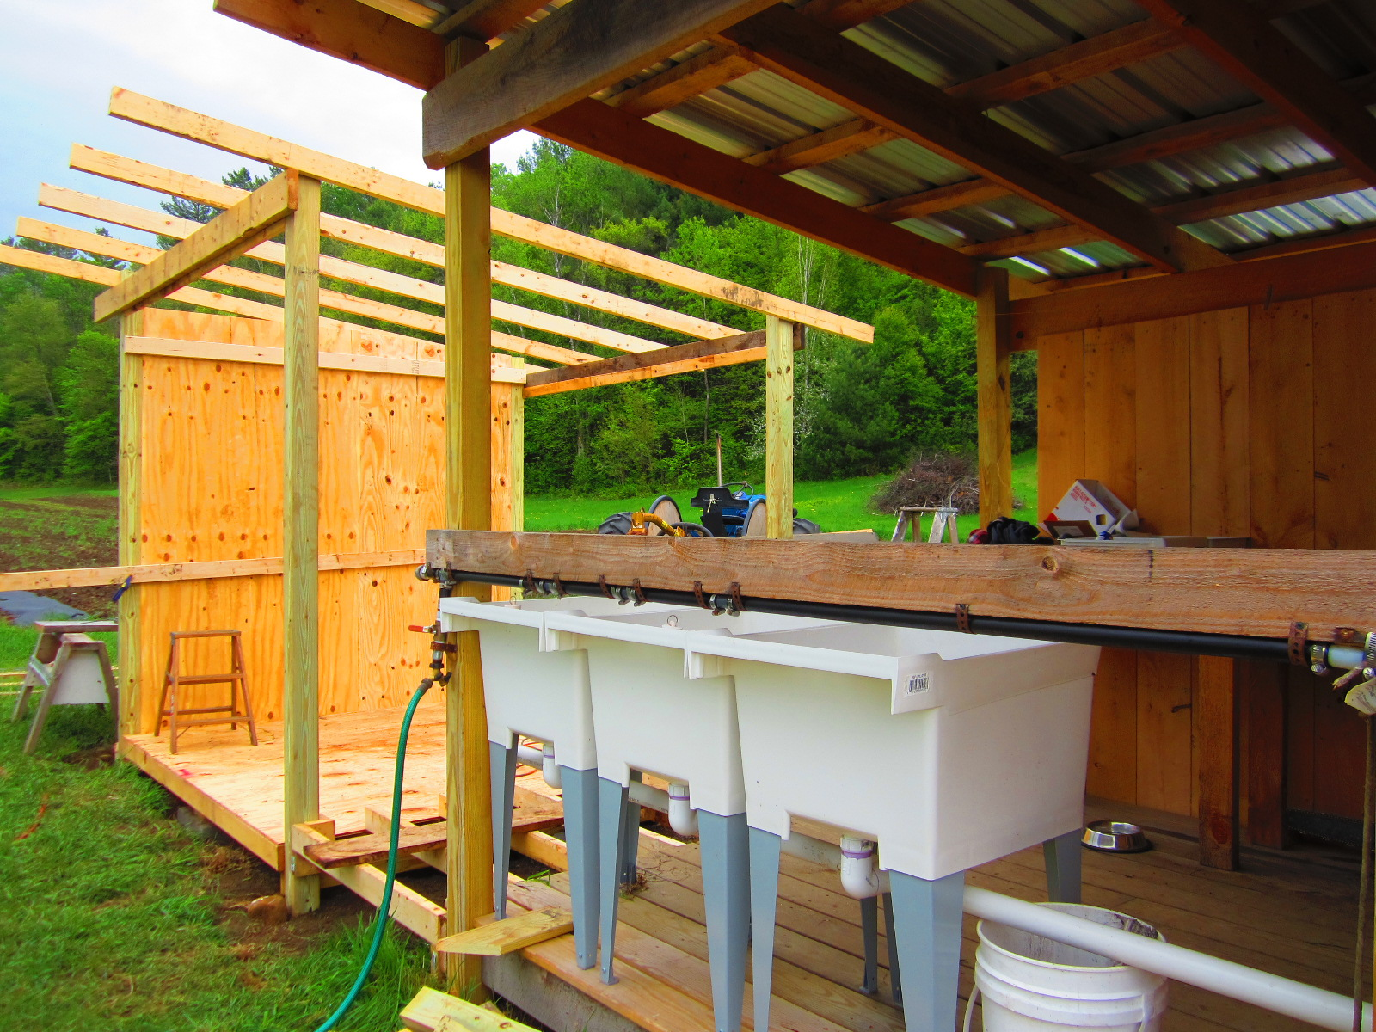

Slide 8
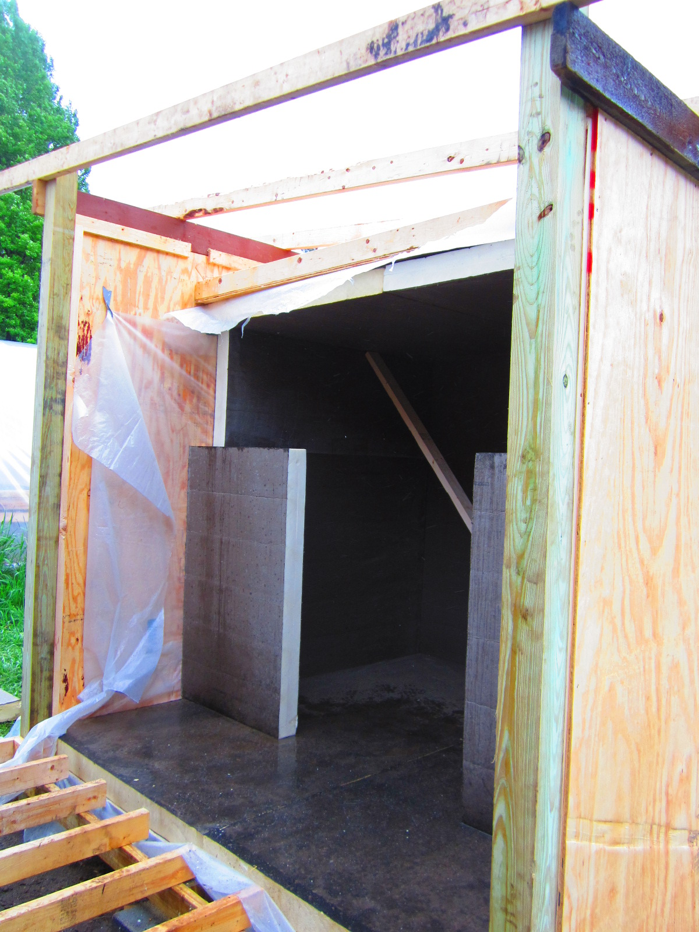
Walk-In Construction
Used the cool-bot website for design ideas
Keeping the floor level with packhouse and a continuous roofline meant a low cooler ceiling (6’).
4” Poly ISO insulation, R-23
Purchased insulated door, then cut to fit.
10,000 BTU A/C unit with Cool-Bot

Slide 9
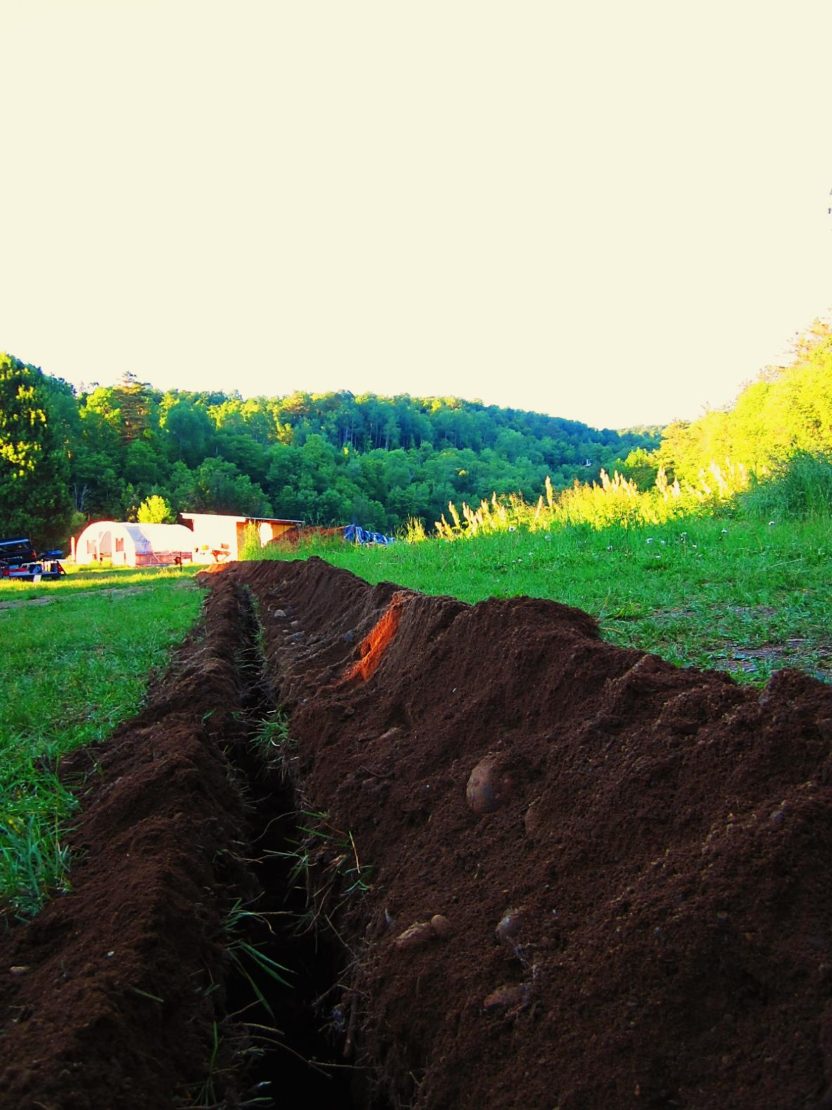
Utilities
200 feet of buried wire and ethernet cable
40 Amp service with subpanel at packhouse
Packhouse becomes the main electrical and communications hub for the farm

Slide 10
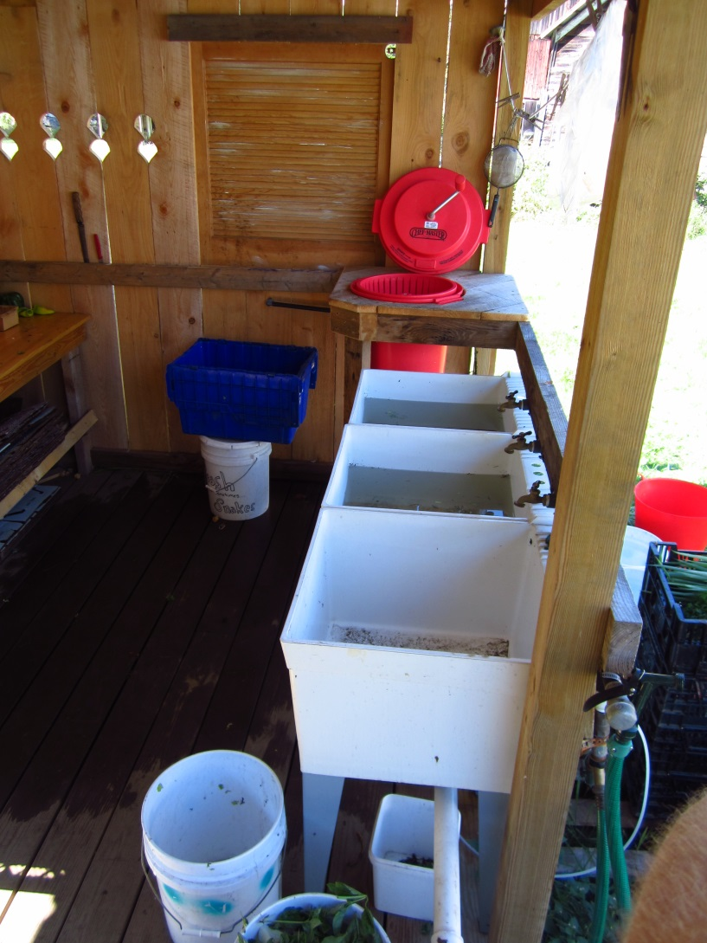
Farm-Specific Design
Wholesale Produce:
Picked to order
Primarily Greens: bunched and loose leaf
Retail Produce:
Picked weekly
Smaller volume of diverse mixed vegetables
Run by 1 person
Contains everything we need to fill orders
Limits of space match those of our acreage

Slide 11
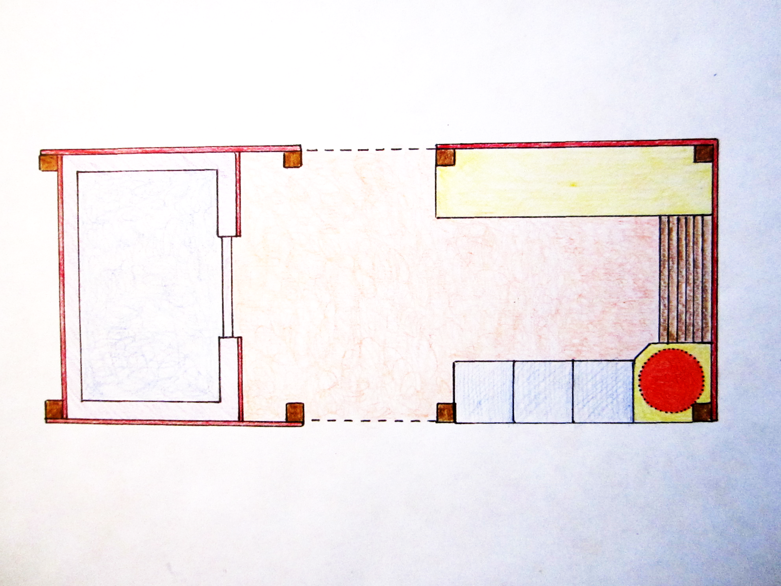
Designing Flow for
Food Safety & Efficiency
Walk-in
Cooler
Triple – rinse for greens
Flow
PICK – RINSE – PACK – STORE - SEND

Slide 12
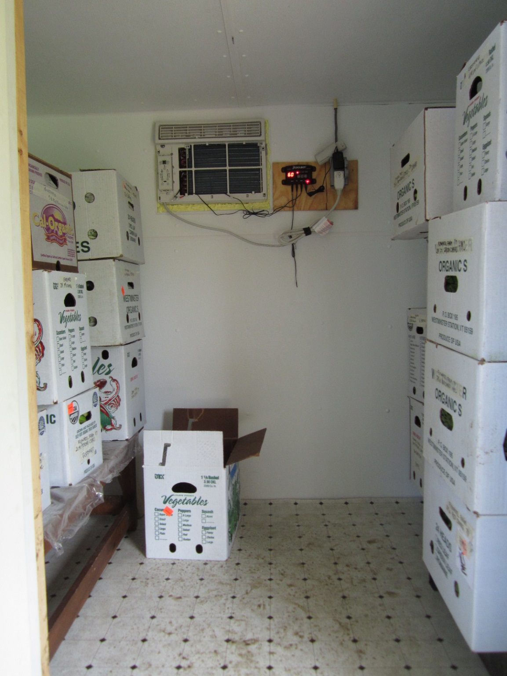
Cooler Interior
Cases are easy to pack in; cooler is easy to clean out
vinyl flooring
walls and ceiling are FRP wall board
Removable, off-the-floor shelving system

Slide 13
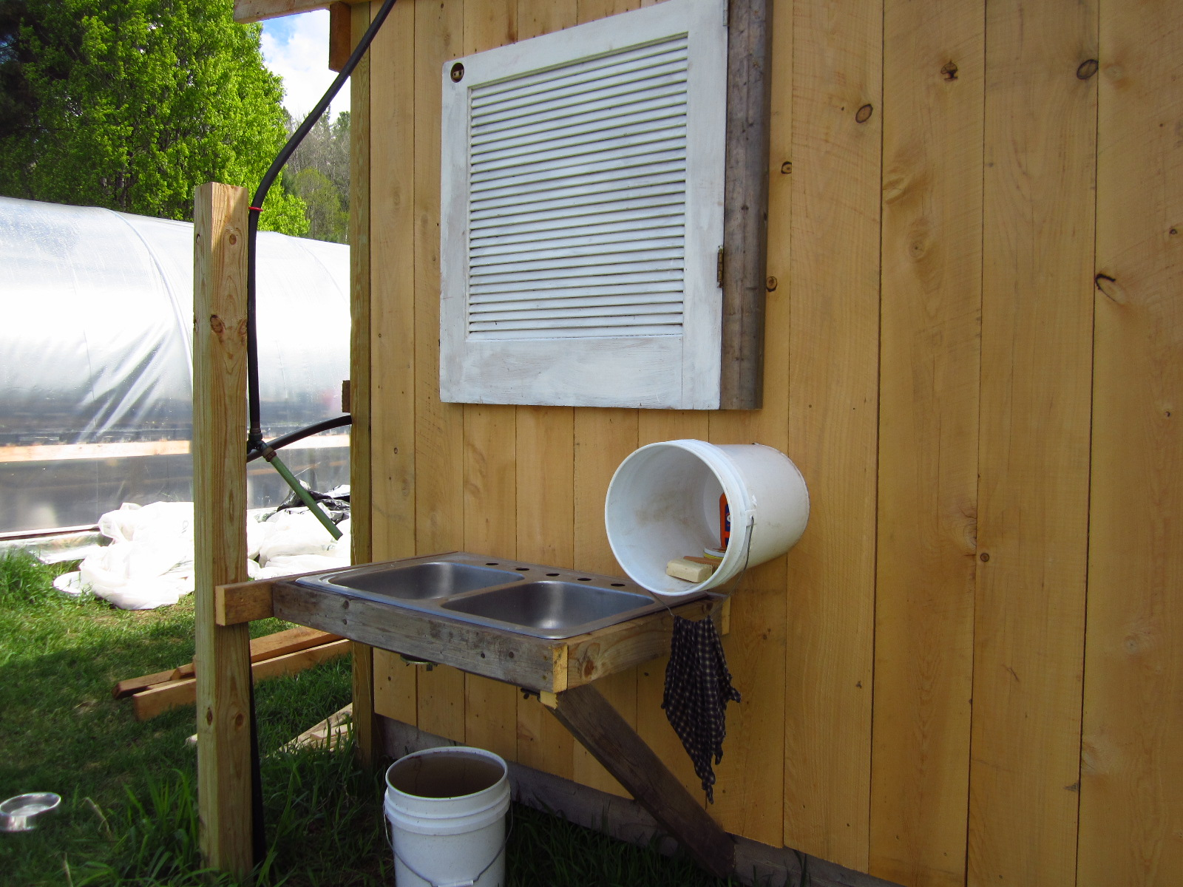
Separate hand- and tool-washing sink outside packhouse
Clearly marked Harvest buckets stored separately
Clearly marked ‘Compost,’ ‘Rabbit’ and ‘Trash’ bins

Slide 14
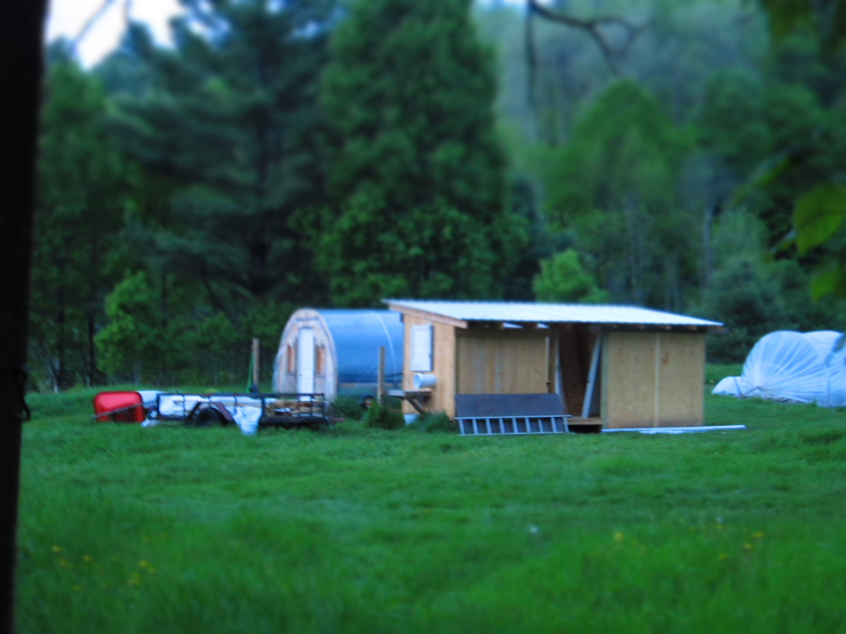
Material & Equipment Costs
2013 Prep Area Structure with Sinks and Fittings $ 720
2014 Prep Area Walls and Cooler Expansion $ 1,700
A/C & Cool-Bot $ 600
Electric and Phone/Internet $ 680
Total $ 3,700

Slide 15
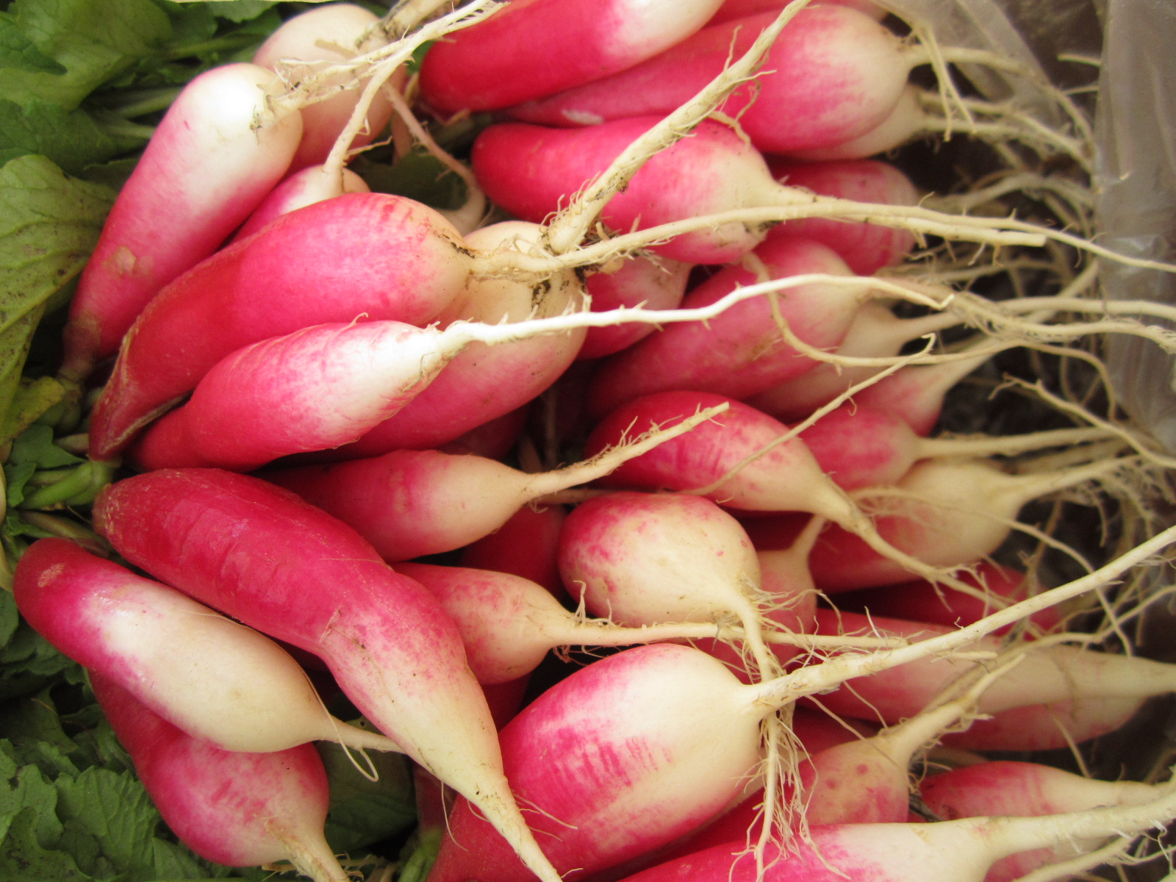
Using the space
Forms the Center of the Farm
Only shady, out-of-the-dirt place to sit
Farm office: take orders, check messages
Where we charge batteries, scales
Water hub: where we hook up drip irrigation
Refrigerator can fit inside cooler (zone potential)
Cooler can be made freeze-proof

Slide 16
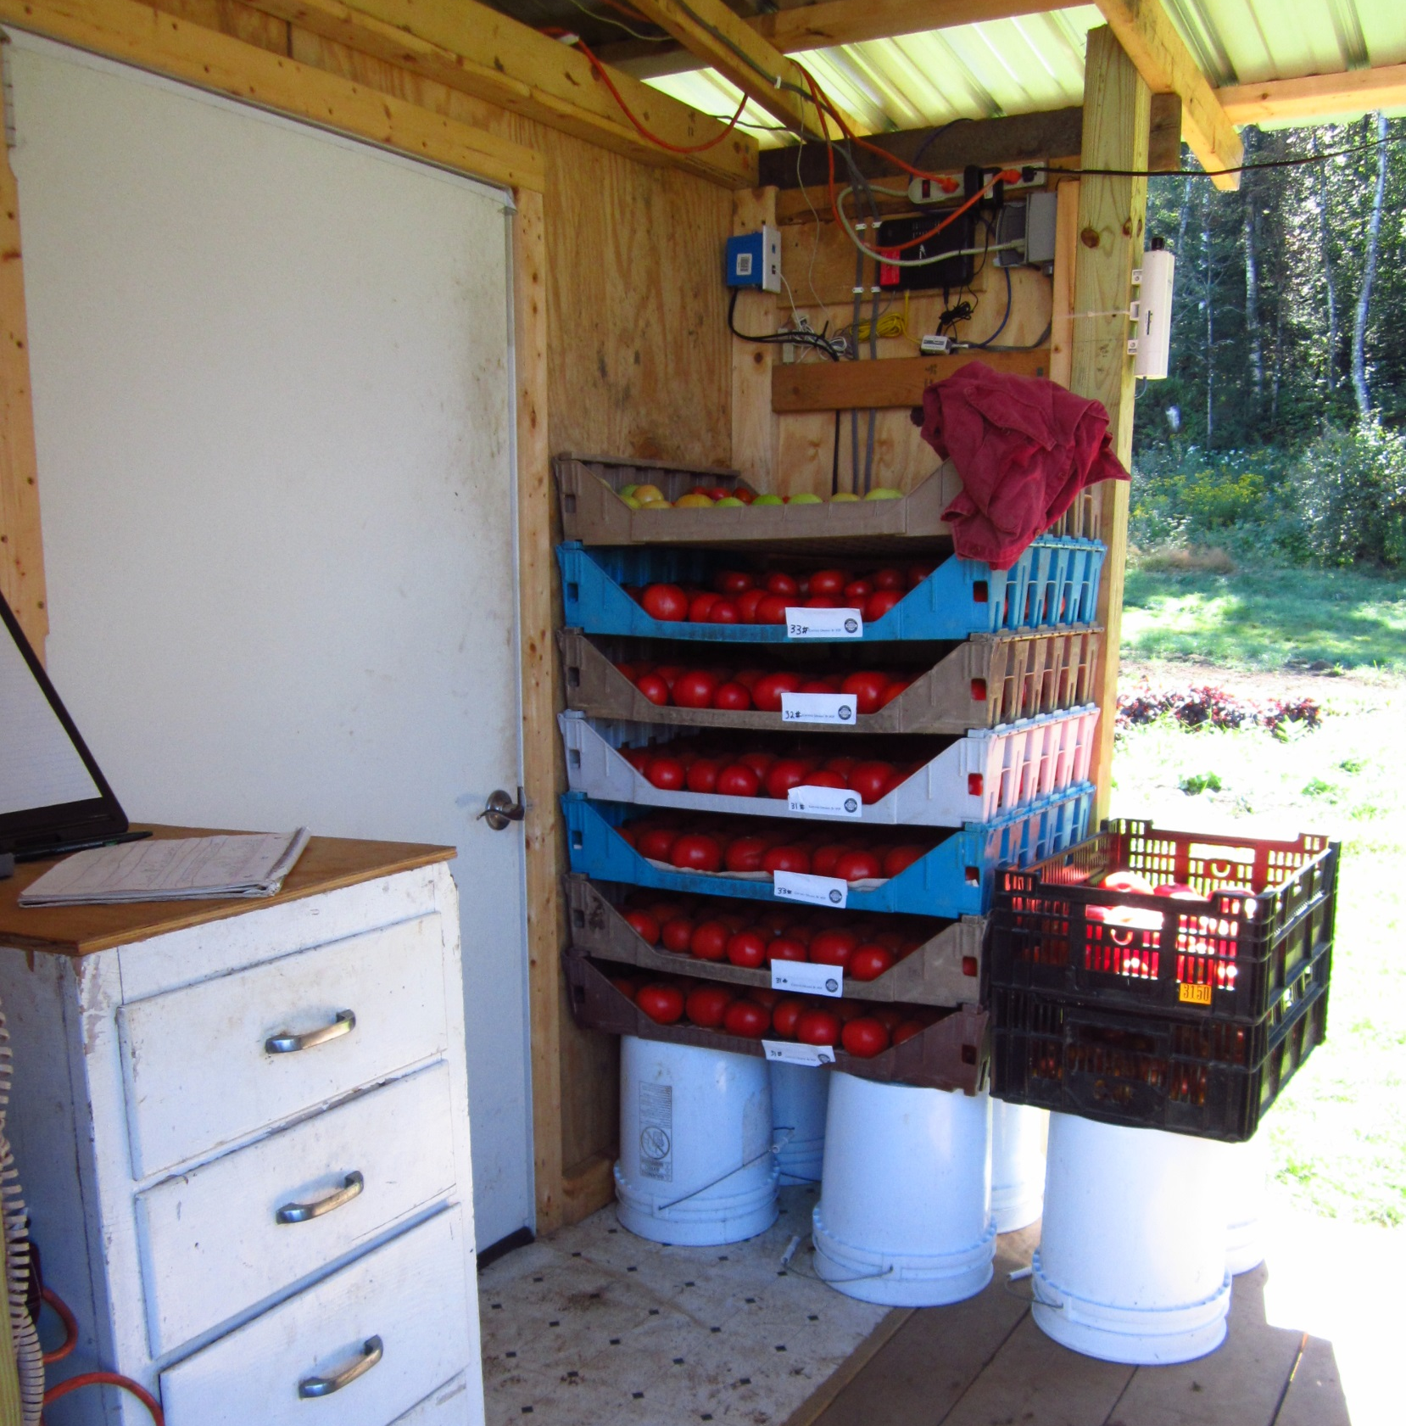
Improving the Space
Current Issues
Becomes a magnet for tools that get only halfway back to the barn…
1) Clean up at the end of the day
2) Have a place to hang tools up
Build-up of non-refrigerated produce
1) Sell that stuff
Next Projects
Complete drainage
Add heater so cooler doesn’t freeze in winter

